Slide 1
Final Year Project Proposal
Realization and Implementation of Communication for Hearing Impaired and Inarticulate People
Group Members
Muhammad Faizan Ikram
Tanzila Iram
Supervisor and Co-Supervisor
Dr. Sajjad Ur Rehman
Dr. Majid Ali

Slide 2
Outline
Project Goal
Environment & Equipment
Implementation Plan
Dataset collection
Related work
Advantages of our proposed system
Sustainable Development Goals
Applications
Budget
Work Distribution
Project Timeline
References

Slide 3
Introduction
Natural Language Processing
Human-Computer Interaction & Natural Languages
Sign recognition
Reducing Communication barrier

Slide 4
Project Goal
The project aims to design a system to communicate with deaf-mute people.
The main aim is to develop a mobile application that can be used to communicate and understand the sign language of disabled people.
Sign to Speech conversion

Slide 5
Environment & Equipment
Equipment & Environment
Software
Mobile Application

Slide 6
Implementation Plan
Sign from Specially-abled person
Sign Image Pre- Processing
Machine Learning Algorithm
Mobile Application Integration
Text to Speech Conversion
Sign to Text Conversion

Slide 7
Dataset Collection
Training Dataset
Testing Dataset
Open source
Data requests to researchers
Practical data collection from disable people

Slide 8
Limitations in Previous Work
Sign to speech conversion using sensor based gloves [1]
Hardware is required
Web application to convert sign alphabets[2]
Desktop application to convert American sign language to speech [3]
This system uses separate camera or web camera to take samples and then process them.

Slide 9
Advantages of our Proposed System
No Hardware Requirement and Cost Free
Word-Level Sign Recognition
Mobile Application instead of web/desktop application
Free app to facilitate deaf-mute and to understand their sign language

Slide 10

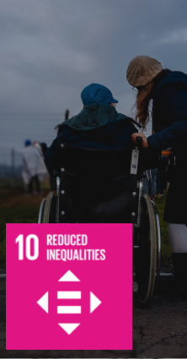
Sustainable Development Goals
Target 8.5
Target 10.2 & 10.3
UN SDGs: Images taken from [5]

Slide 11
Applications
Group-A
Group-B
Group-C
Facilitate hearing impaired and inarticulate people to communicate with other world.
Can be used by non-disabled people to understand and also learn sign language.
Can be used by professional community to understand the sign language of disabled people and respond them accordingly.

Slide 12
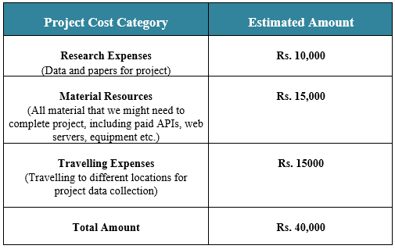
Budget

Slide 13
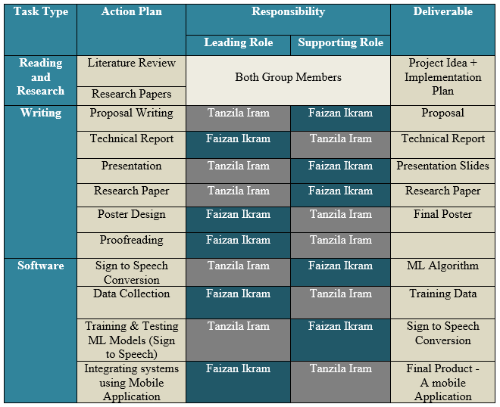
Work Distribution

Slide 14
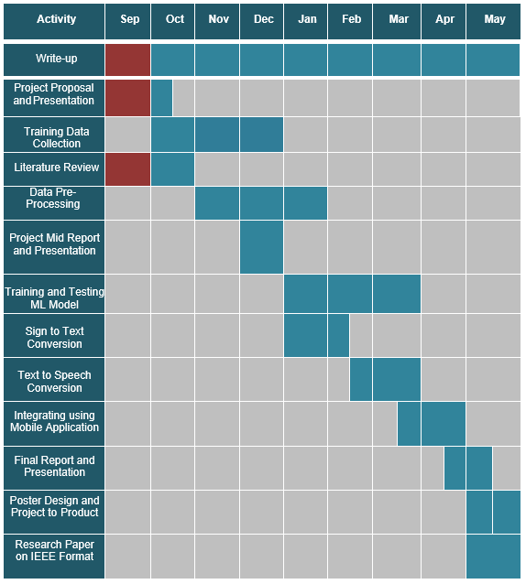
Project Timeline
Achieved
Future Work

Slide 15
References
[1] P. D. Rosero-Montalvo et al., "Sign Language Recognition Based on Intelligent Glove Using Machine Learning Techniques," 2018 IEEE Third Ecuador Technical Chapters Meeting (ETCM), 2018, pp. 1-5, doi: 10.1109/ETCM.2018.8580268.
[2] Mahesh Kumar, “Conversion of Sign Language into Text” International Journal of Applied Engineering Research ISSN 0973-4562 Volume 13, Number 9 (2018) pp. 7154-7161
[3] Mirzaei, M.R., Ghorshi, S. & Mortazavi, M. “Audio-visual speech recognition techniques in augmented reality environments.” Vis Comput 30, 245–257 (2014). https://doi.org/10.1007/s00371-013-0841-1
[4] K. Dabre and S. Dholay, "Machine learning model for sign` language interpretation using webcam images," 2014 International Conference on Circuits, Systems, Communication and Information Technology Applications (CSCITA), 2014, pp. 317-321, doi: 10.1109/CSCITA.2014.6839279.
[5] Sustainable Development Goals [Online] Available at: https://sdgs.un.org/goals

Slide 16
Thank You Everyone
Any Question/Remarks?

